Slide 1
CHAPTER 6
SORTING

Slide 2
Problem and solving algorithm
a)Bubble sort algorithm
b) Merging sort algorithm
c)Selection sort algorithm
d) Insertion sort algorithm
e) Quick sort algorithm

Slide 3
Bubble Sort
Bubble sort is a sorting algorithm that compares two adjacent elements and swaps them until they are not in the intended order.
Just like the movement of air bubbles in the water that rise up to the surface, each element of the array move to the end in each iteration. Therefore, it is called a bubble sort.

Slide 4
Working of Bubble Sort
Suppose we are trying to sort the elements in ascending order.
1. First Iteration (Compare and Swap)
Starting from the first index, compare the first and the second elements.
If the first element is greater than the second element, they are swapped.
Now, compare the second and the third elements. Swap them if they are not in order.
The above process goes on until the last element.

Slide 5
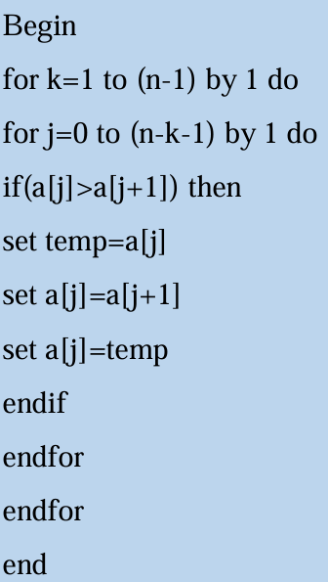
Bubble Sort algorithm
Apply the algorithm to
a = [5, 3, 8, 1]

Slide 6
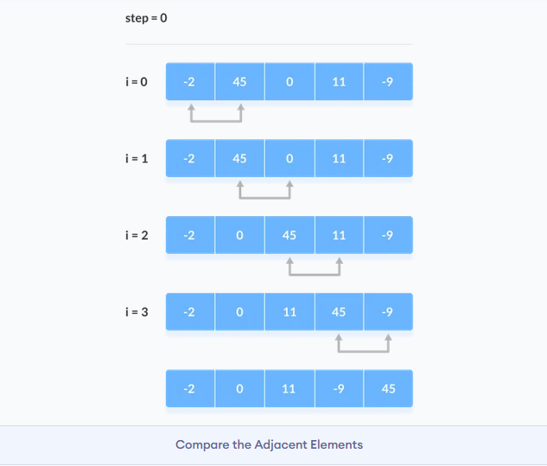
2. Remaining Iteration
The same process goes on for the remaining iterations.
After each iteration, the largest element among the unsorted elements is placed at the end.

Slide 7
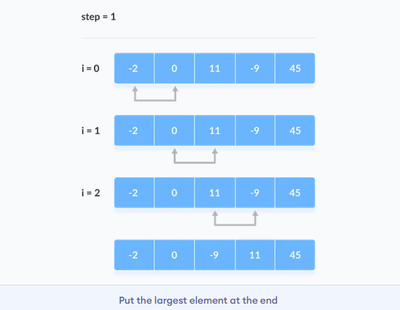
In each iteration, the comparison takes place up to the last unsorted element.

Slide 8
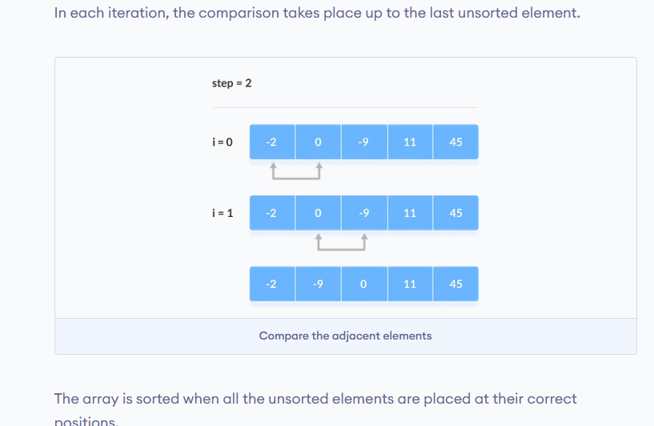

Slide 9
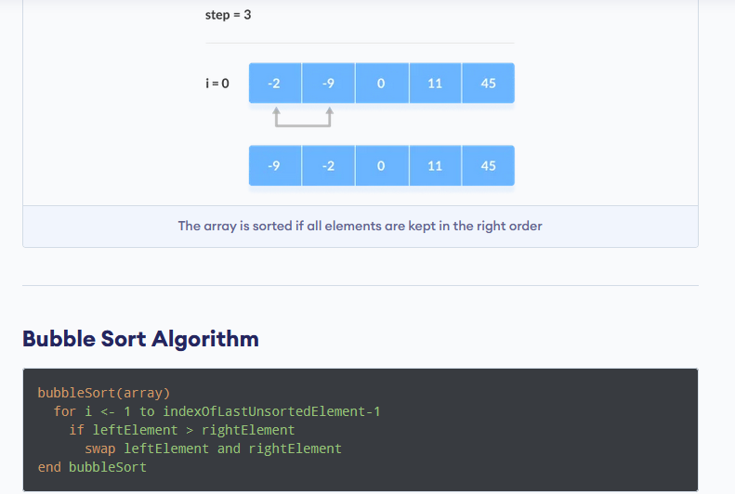

Slide 10
EXERCISES
Consider the elements in Array
{10, 9, 8, 7, 6, 5, 4, 3, 2, 1}
sort the array element using bubble sort algorithm.

Slide 11
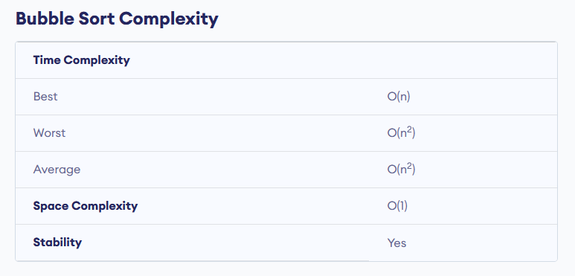

Slide 12
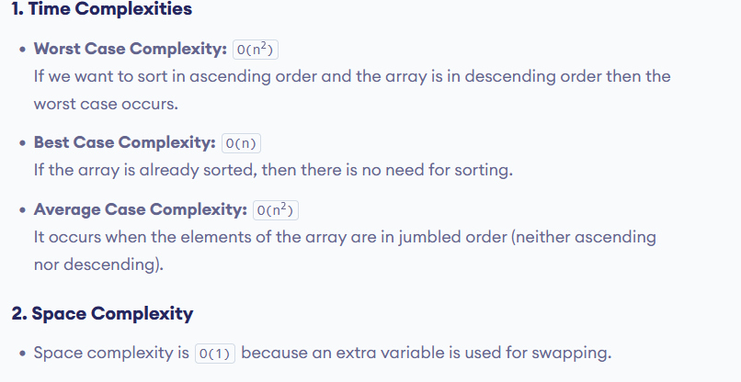

Slide 13
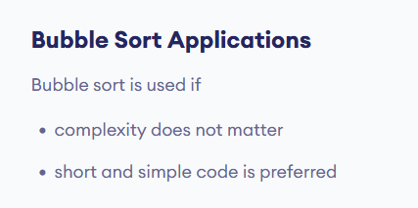

Slide 14
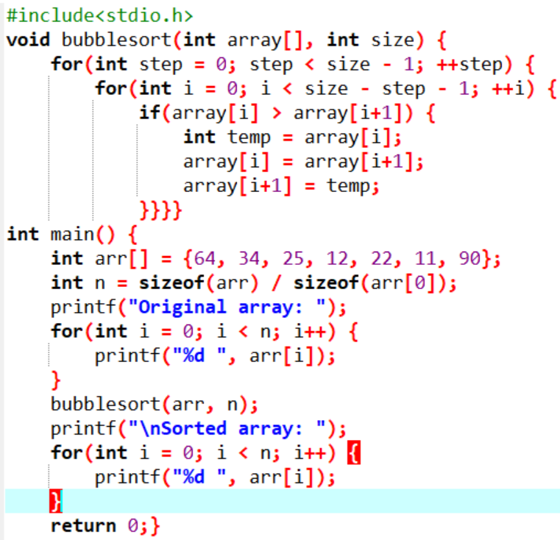

Bubble sort program example
Output

Slide 15
Problem and solving algorithm
a)Merging sort algorithm
The merge sort method follows the technique of divide and conquer.in the merge sort the given elements are divided into two sets A[0]…….A[(N/2)-1] and [N/2]…..A[N-1]J
The technique described above can be performed in the following steps.
Step1:Divide the sequence of elements into two equal parts.
Step2:Recursively sort the elements of the left part
Step3:Recursively sort the elements of the right part
Step4:Mergethe sorted left and sorted right parts into a single sorted array

Slide 16
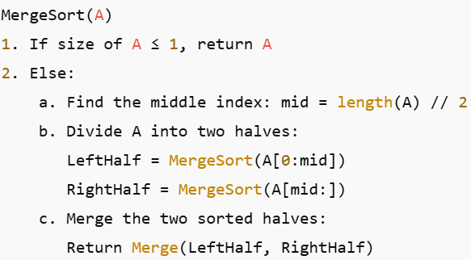
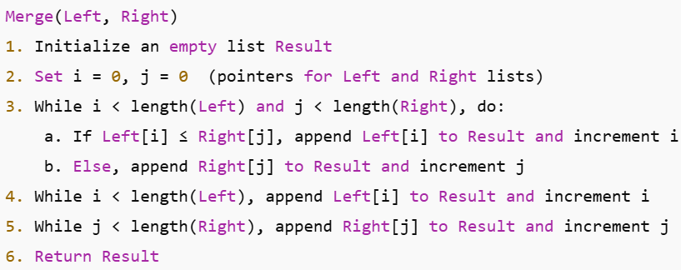
Merging sort algorithm

Slide 17
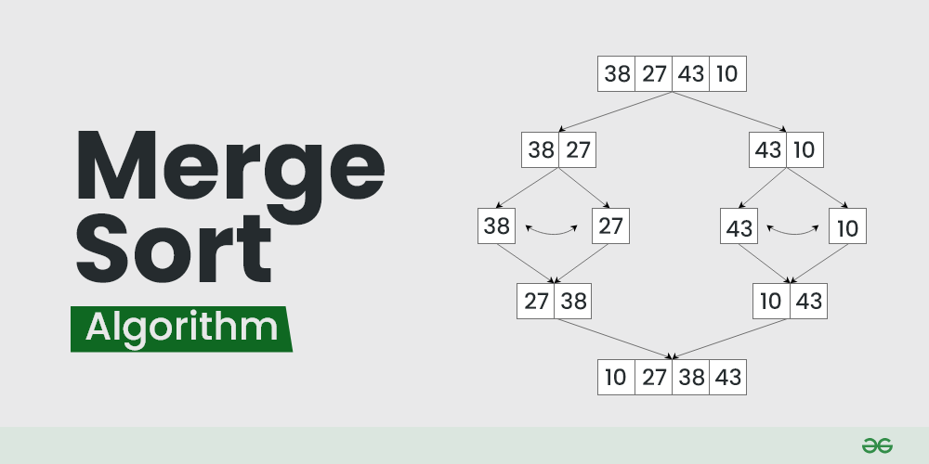
MERGE sort example 1

Slide 18
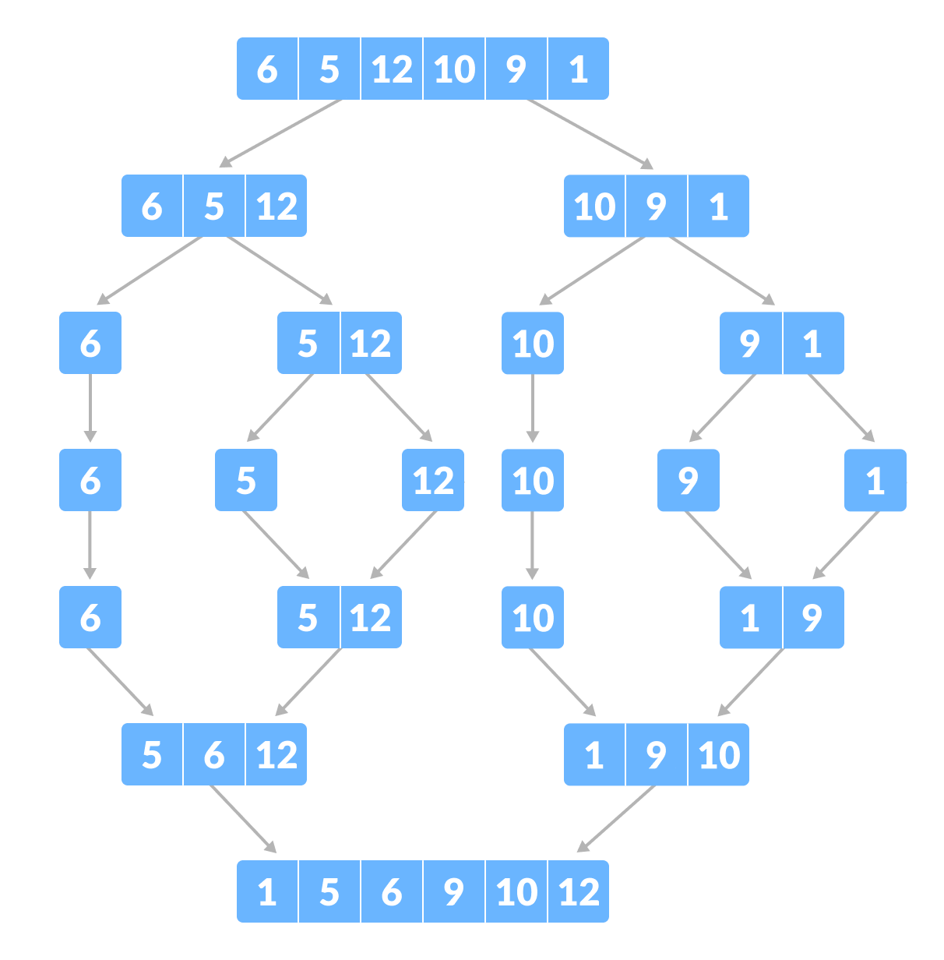
MERGE sort example 2

Slide 19
Problem and solving algorithm
EXERCISE: show merge sort algorithm to solve the following problem
35 | 10 | 15 | 45 | 25 | 20 | 40

Slide 20
Complexity
Time Complexity:
Best Case: O(nlog⁡n)
Worst Case: O(nlog⁡n)
Average Case: O(nlog⁡n)
Space complexity:
Space: O(n)

Slide 21
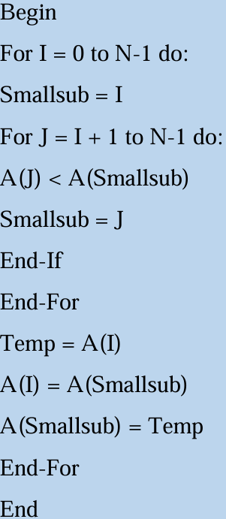
Selection Sort Algorithm

Slide 22
Selection Sort Algorithm
The selection sort algorithm is a simple, yet effective sorting algorithm. A selection-based sorting algorithm is described as an in-place comparison-based algorithm that divides the list into two parts, the sorted part on the left and the unsorted part on the right. Initially, the sorted section is empty, and the unsorted section contains the entire list. When sorting a small list, selection sort can be used.

Slide 23
What Is a Selection Sort Algorithm?
Selection sort is an effective and efficient sort algorithm based on comparison operations.
It adds one element in each iteration.
You need to select the smallest element in the array and move it to the beginning of the array by swapping with the front element.
You can also accomplish this by selecting the most potent element and positioning it at the back end.
In each iteration, selection sort selects an element and places it in the appropriate position.

Slide 24
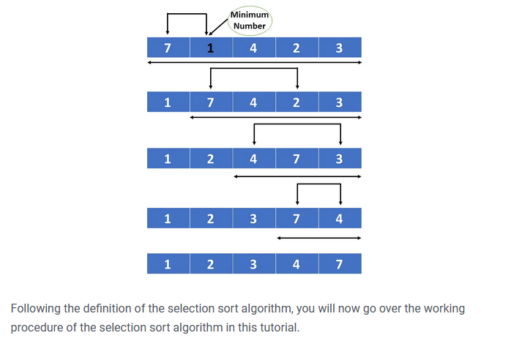

Slide 25
How Does the Selection Sort Algorithm Work?
Selection sort works by taking the smallest element in an unsorted array and bringing it to the front. You’ll go through each item (from left to right) until you find the smallest one. The first item in the array is now sorted, while the rest of the array is unsorted.
As an example, consider the array depicted below.

Slide 26
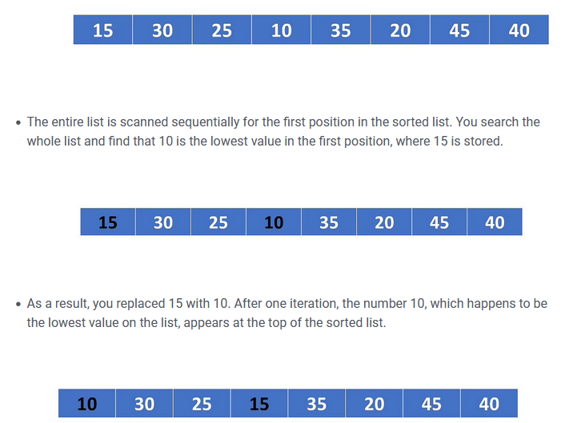

Slide 27
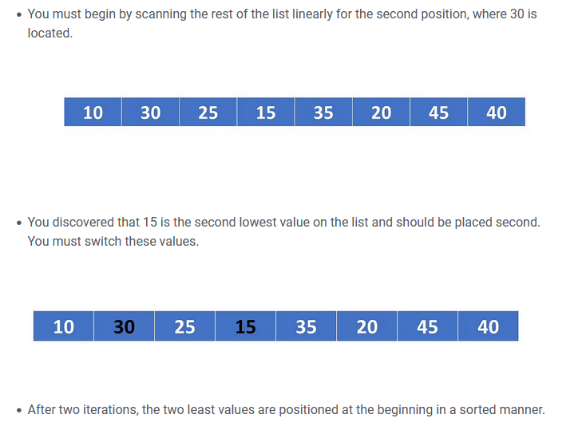

Slide 28
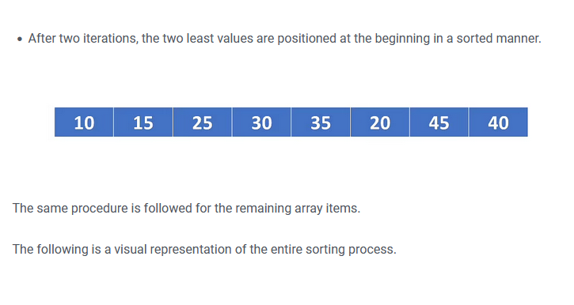

Slide 29
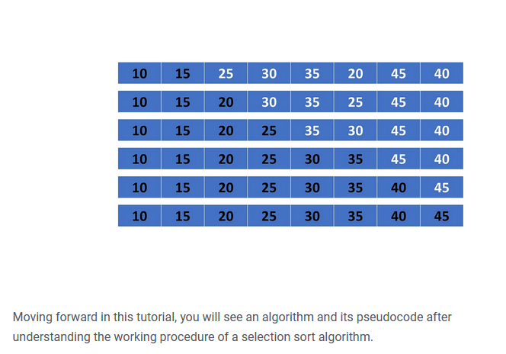

Slide 30
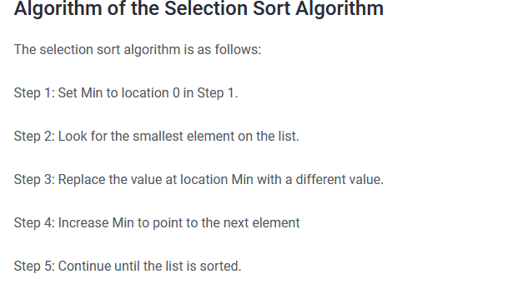

Slide 31
Exercises
Input: N = 10 arr[] = {10, 9, 8, 7, 6, 5, 4, 3, 2, 1}
Sort the array element using selection sort

Slide 32
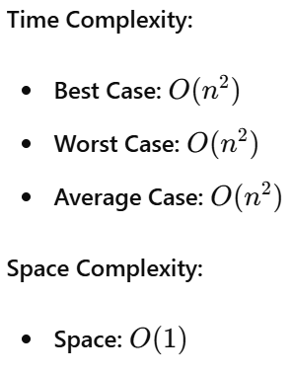
Selection sort complexity

Slide 33
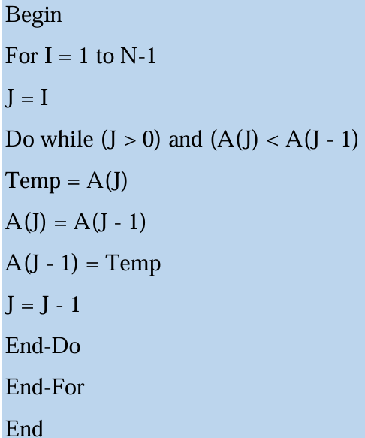
Insertion Sort algorithm

Slide 34
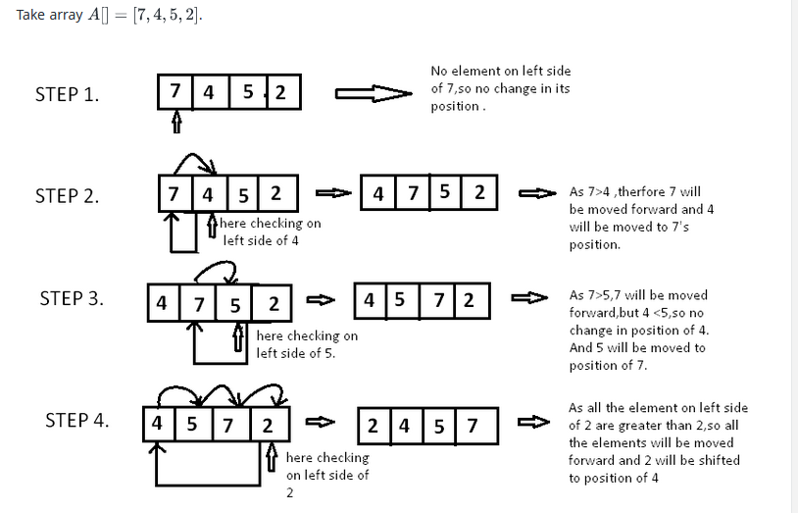

Slide 35
Insertion sort illustration

Slide 36
Insertion sort is based on the idea that one element from the input elements is consumed in each iteration to find its correct position i.e, the position to which it belongs in a sorted array.

Slide 37
It iterates the input elements by growing the sorted array at each iteration. It compares the current element with the largest value in the sorted array. If the current element is greater, then it leaves the element in its place and moves on to the next element else it finds its correct position in the sorted array and moves it to that position. This is done by shifting all the elements, which are larger than the current element, in the sorted array to one position ahead

Slide 38
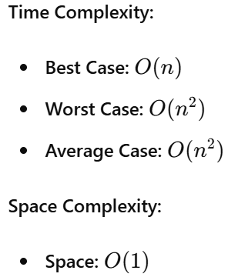
Insertion sort complexity

Slide 39
Quick Sort
Quick sort is also known as Partition-exchange sort based on the rule of Divide and Conquer.
It is a highly efficient sorting algorithm.
Quick sort is the quickest comparison-based sorting algorithm.
It is very fast and requires less additional space, only O(n log n) space is required.
Quick sort picks an element as pivot and partitions the array around the picked pivot.

Slide 40
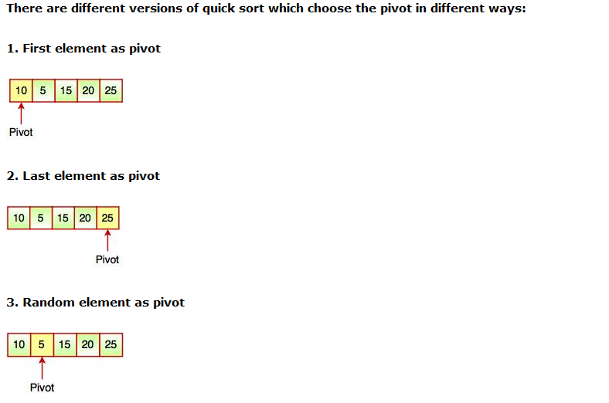

Slide 41
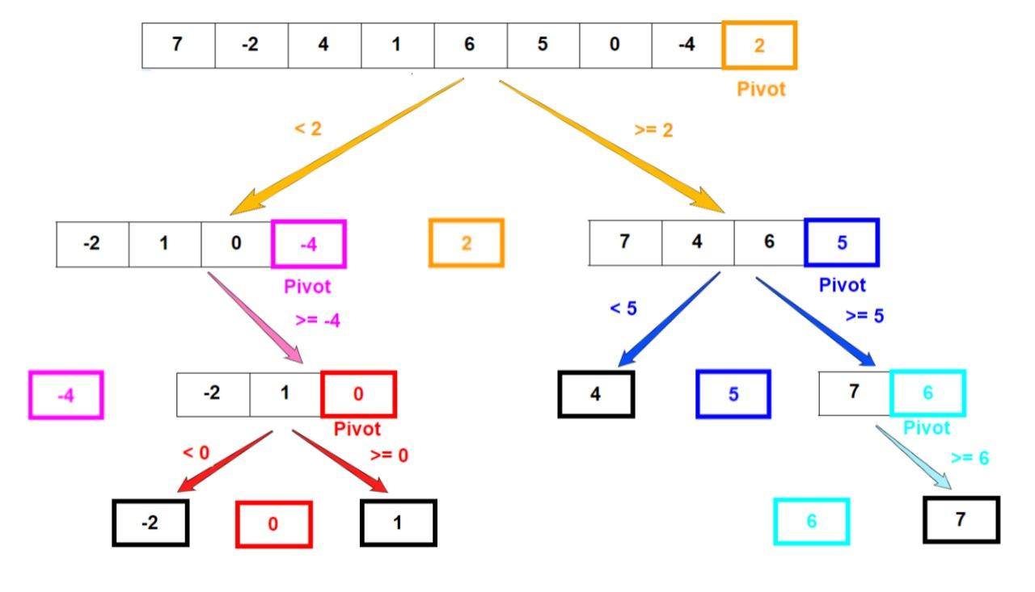
QUICK SORT ILLUSTRATION

Slide 42
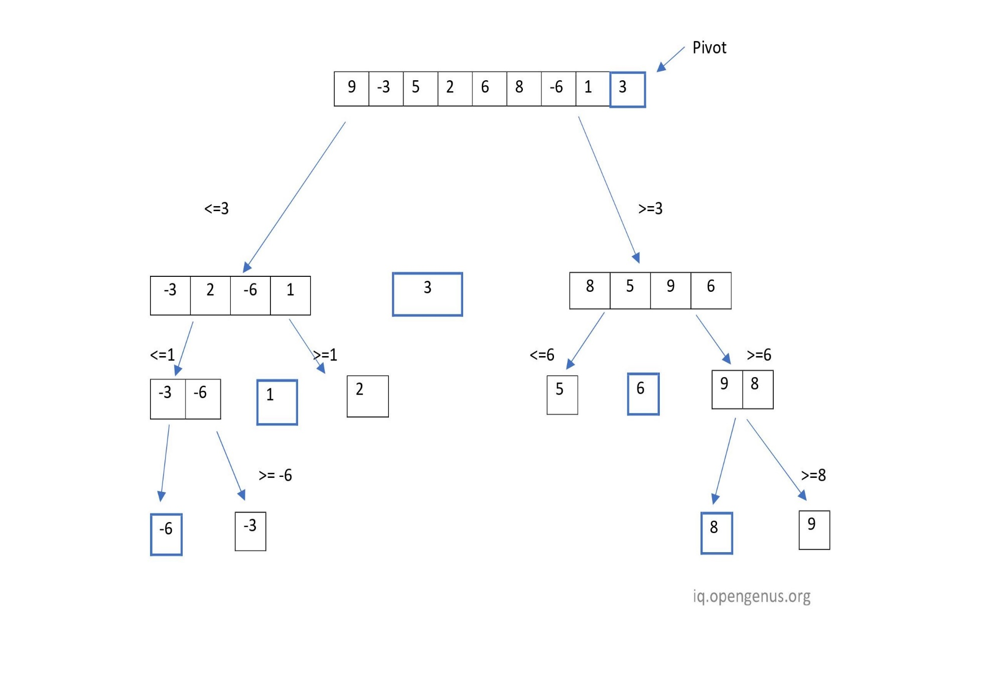

Slide 43
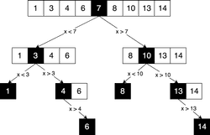

Slide 44
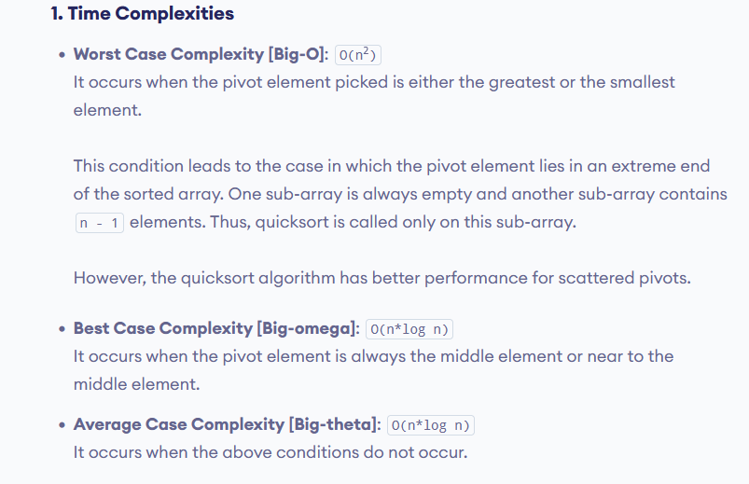
Time Completies

Slide 45
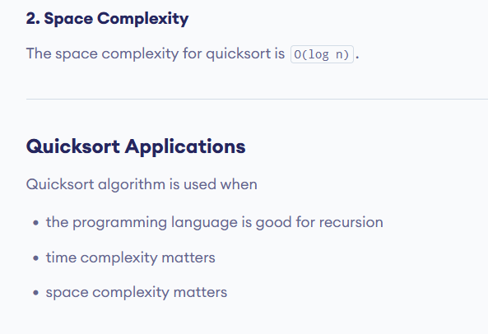

Slide 46
Advantages of Quick Sort:
It is a divide-and-conquer algorithm that makes it easier to solve problems.
It is efficient on large data sets.
It has a low overhead, as it only requires a small amount of memory to function.

Slide 47
Disadvantages of Quick Sort:
It has a worst-case time complexity of O(N²), which occurs when the pivot is chosen poorly.
It is not a good choice for small data sets.
It is not a stable sort, meaning that if two elements have the same key, their relative order will not be preserved in the sorted output in case of quick sort, because here we are swapping elements according to the pivot’s position (without considering their original positions).

Slide 48
END

